Slide 1
IRHA’S BIRTHDAY PARTY
15-dec-2024

Slide 2
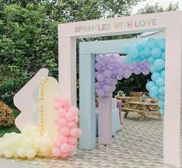

ENTRANCE
PURPLE, BLUE PINK
AND YELLOW BALLOONS

Slide 3
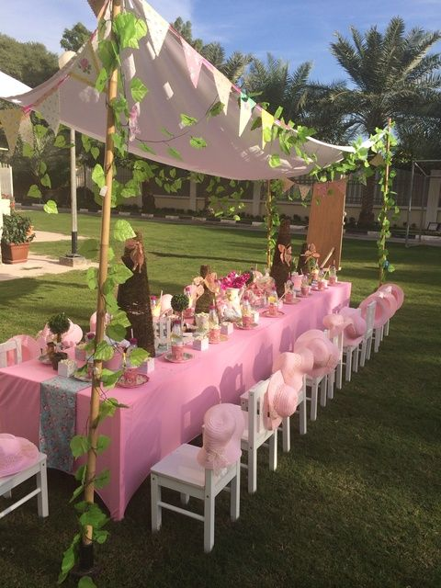
ARRANGEMENTS
SELECT OPEN VENUE
THEME COLOUR IS PINK AND WHITE
DAY LIGHT EVENT
WHITE TABLE WITH PINK TABLE COVER
WHITE CHAIRS

Slide 4
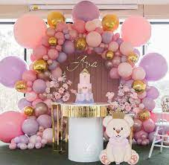
STAGE SETUP
LIGHT BLUE TABLE
BACKGROUND PINK ,PURPLE AND GOLDEN BALLOONS
PINK FLOWERS
LIGHT PINK TEADY BEAR
GOLDEN COLOUR NAME PIECE

Slide 5
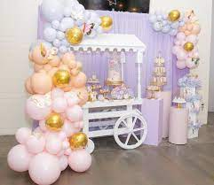
GIFT CORNER
WHITE COLOUR WOOD CART
LIGHT PURPLE PANEL
PINK, PURPLE AND GOLDEN BALLONS
DECORATION TABLES

Slide 6
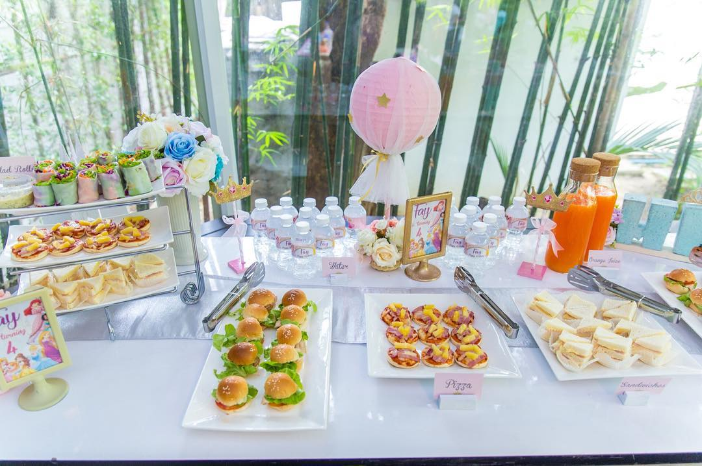
FOOD CORNER
TABLE WITH WHITE COLOUR
WHITE SERVING DISHES
STARTERS: BURGER, SANDWITCHES, DYNAMITE CHICKEN, FRESH JUICES
MAIN COURSE: TIKKA, ROLLS, FISH, GOLGAPPAY, KARAHI, GARLIC NAN.
DESERT: ICE CREAM, CUPCAKES, DONUTS.

Slide 7
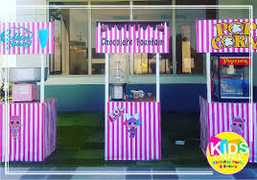
KIDS STALL’S
POPCORN
CHOCOLATE FOUNTAIN
COTTON CANDY

Slide 8
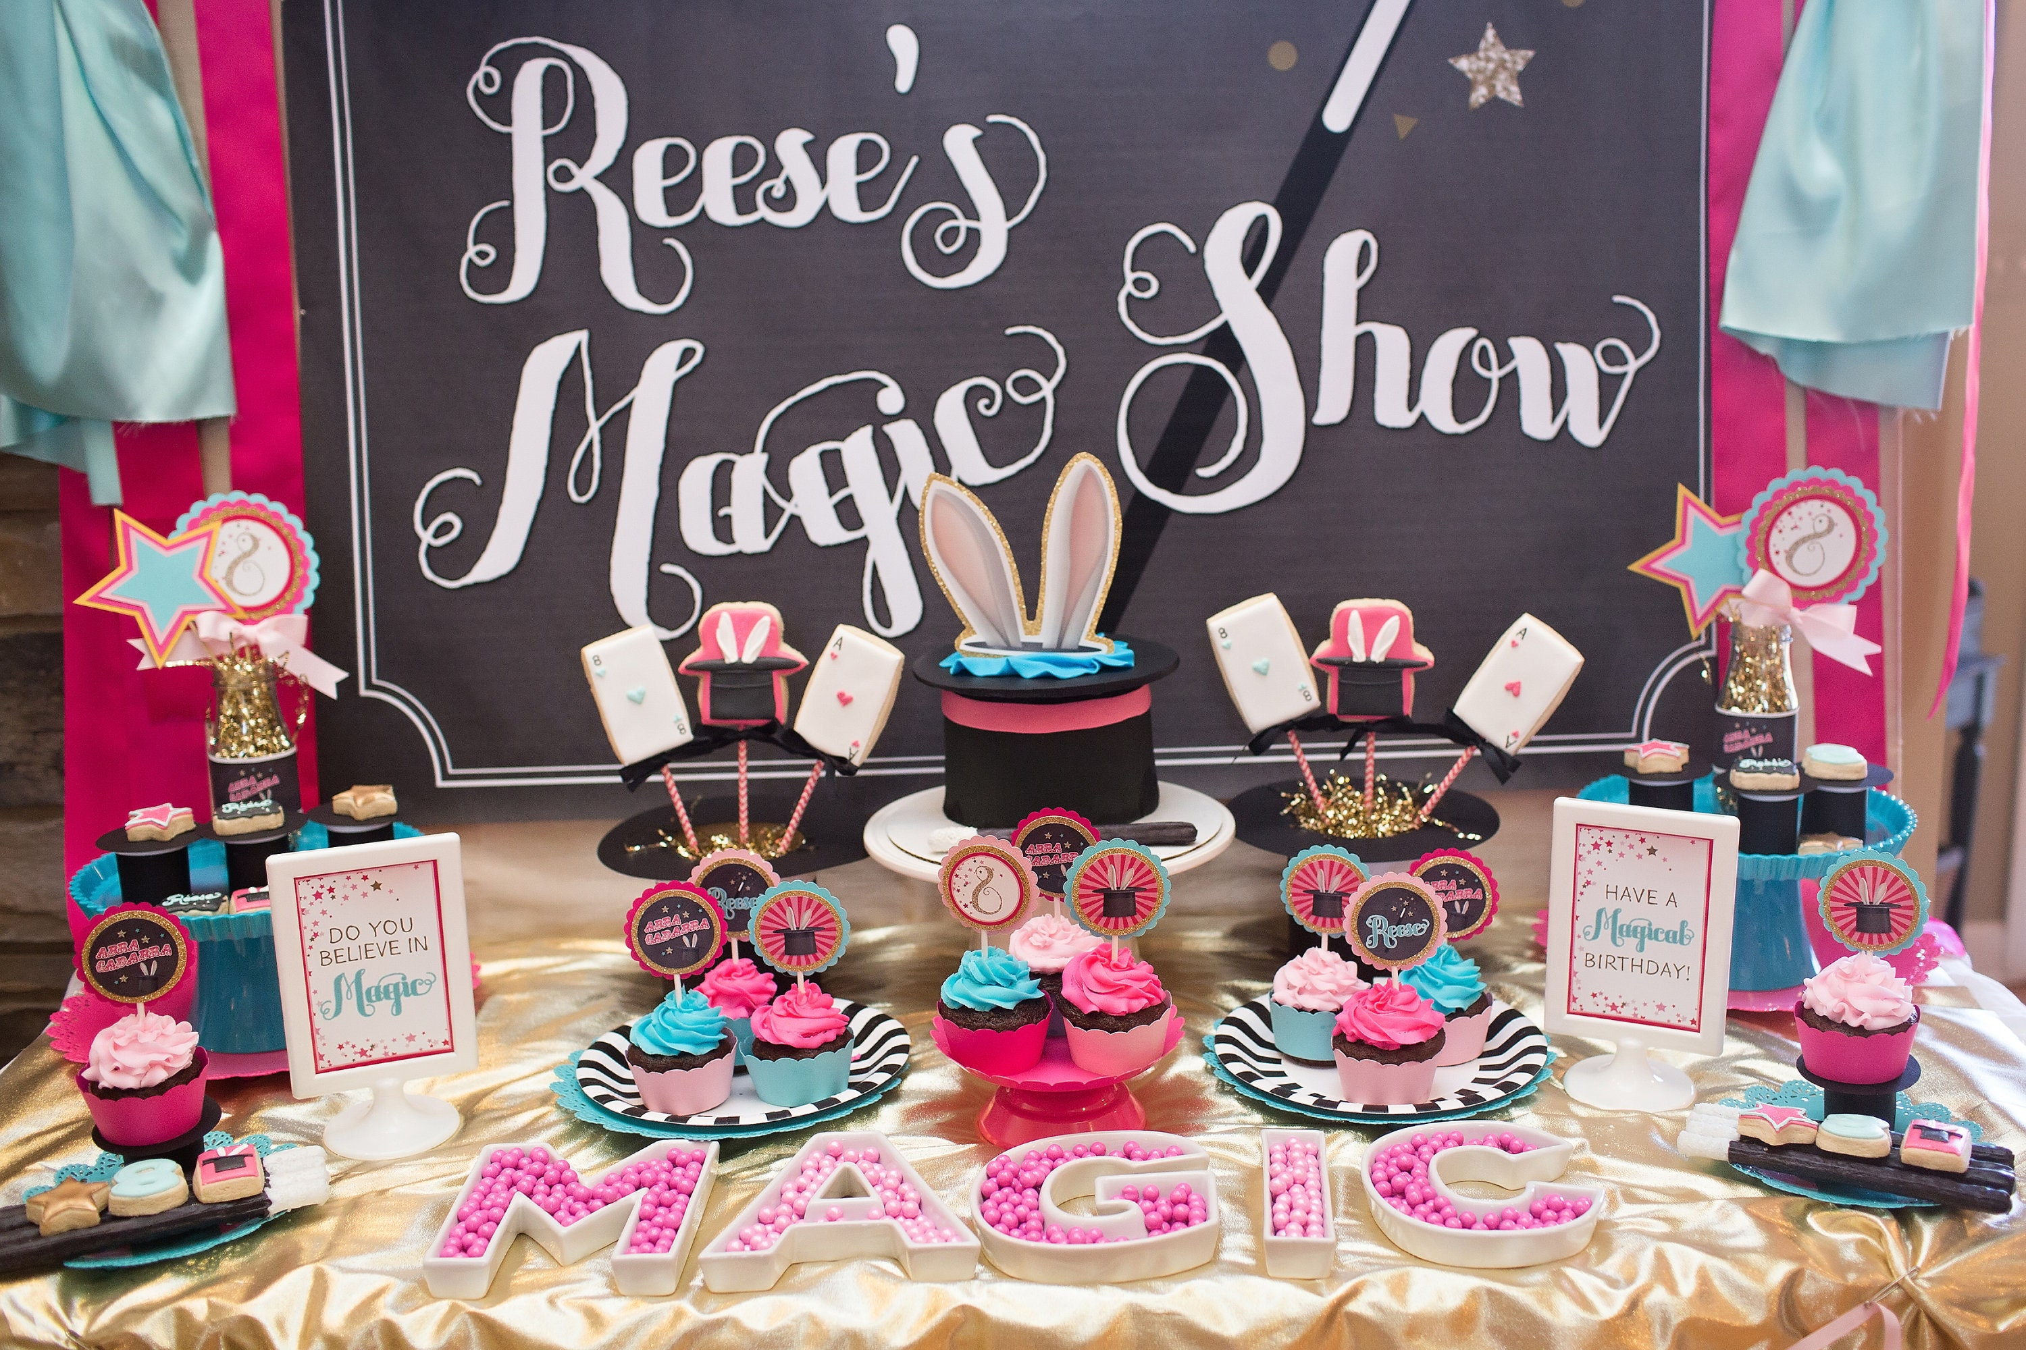
MAGIC SHOW CORNER

Slide 9
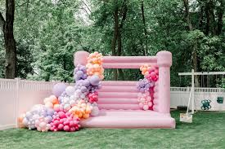
JUMPING CASTLE
PINK JUMPING CASTLE
PINK, PURPLE AND GOLDEN BALLOONS

Slide 10
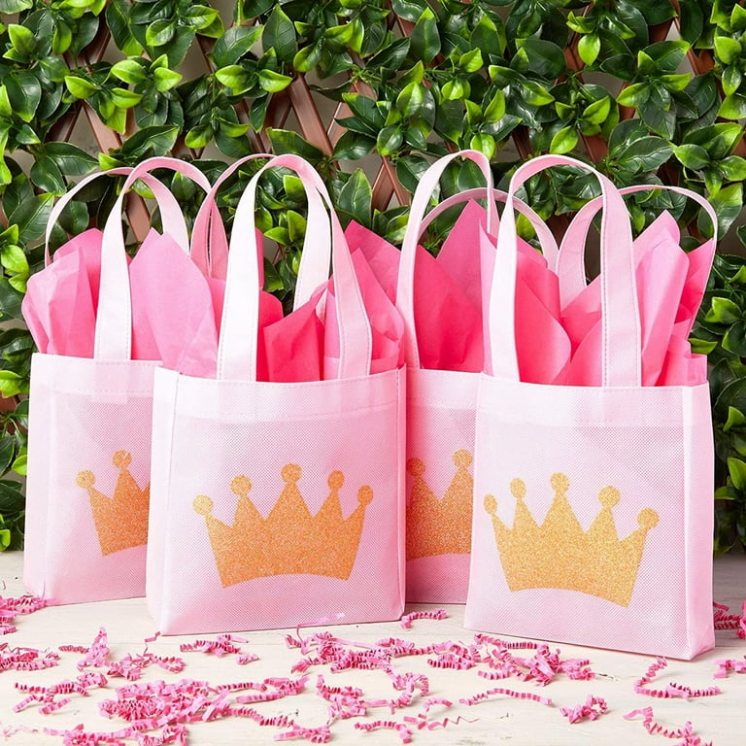
GODDIE BAGS
PINK BAGS
GOLDEN CROWN

Slide 11
THANK YOU
PROJECT NAME
BIRTHDAY PARTY EVENT
GROUP MEMBERS
NOOR NADEEM
IDEA, MS EXCEL AND POVERPOINT PRESENTATION
RAHIMA
MANAGE ACCOUNT
AMNA BAKSH
******

